Slide 1


KIET GROUP OF INSTITUTIONS, GHAZIABAD
(AN ISO – 9001: 2008 CERTIFIED & ‘A+’ GRADE ACCREDITED INSTITUTION BY NAAC)
PROJECT PRESENTATION
PROJECT-ID: PCS 24 46
“NOSQL TO RDBMS CONVERTER”
PROJECT MEMBERS:
1. VAGEESHA RAI (2000290120181)-8C
2. VIKAS KUMAR VERMA (2000290120189)-8C
3. SAUMYA SINGH (2000290120138) - 8C
GUIDE NAME:
PROF. ABHISHEK GOYAL

Slide 2

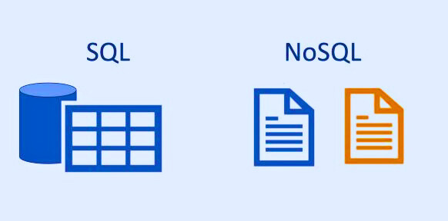

“NOSQL TO RDBMS CONVERTER”

Slide 3






Problem Statement
Many users have valuable data stored in non-SQL formats, such as CSV, Excel, or JSON, but lack the technical knowledge required to convert and store this data in relational database management systems (RDBMS). The absence of accessible tools often presents a significant barrier to these users, limiting their ability to utilize and analyze their data effectively.

Slide 4

Objectives:
01
Schema Transformation:
02
User-friendly Interface:
The project aims to transform the schema and data structure from NoSQL to a format suitable for an RDBMS.
The project should provide a user-friendly interface that allows users to initiate and manage data conversion tasks easily.
03
Single-Platform for Different File Conversions:
The project aims to convert different types of NoSQL files (e.g. .csv, .xml, .json, etc.) into RDBMS files.

Slide 5

Technology Used:
1. PHP
2. XAMPP
3. Database Connectors:
•RDBMS (e.g., MySQL or MariaDB): XAMPP includes MySQL (or
MariaDB), so you can use PHP's built-in MySQL functions or the PDO
extension for connecting to and working with relational databases.
4. Data Serialization/Deserialization:
•JSON: PHP provides built-in support for working with JSON data
using functions like json_encode and json_decode.
•XML: You can use PHP's Simple XML or DOM Document for handling
XML data.
•CSV: PHP offers functions like “fgetcsv” and “fputcsv” for
manipulating CSV data.
5. ETL Logic: Implement the ETL logic using PHP to extract data from the NoSQL source, transform it as needed, and load it into the RDBMS.

Slide 6

WORKFLOW DIAGRAM:
START
SCHEMA
ANALYZER
PARSER
USER LOGIN
MAPPING OF NoSQL
TO RDBMS
USER SELECT
NoSQL DATA TYPE
RDBMS FILE CREATED
CSV
JSON
XML
END

Slide 7
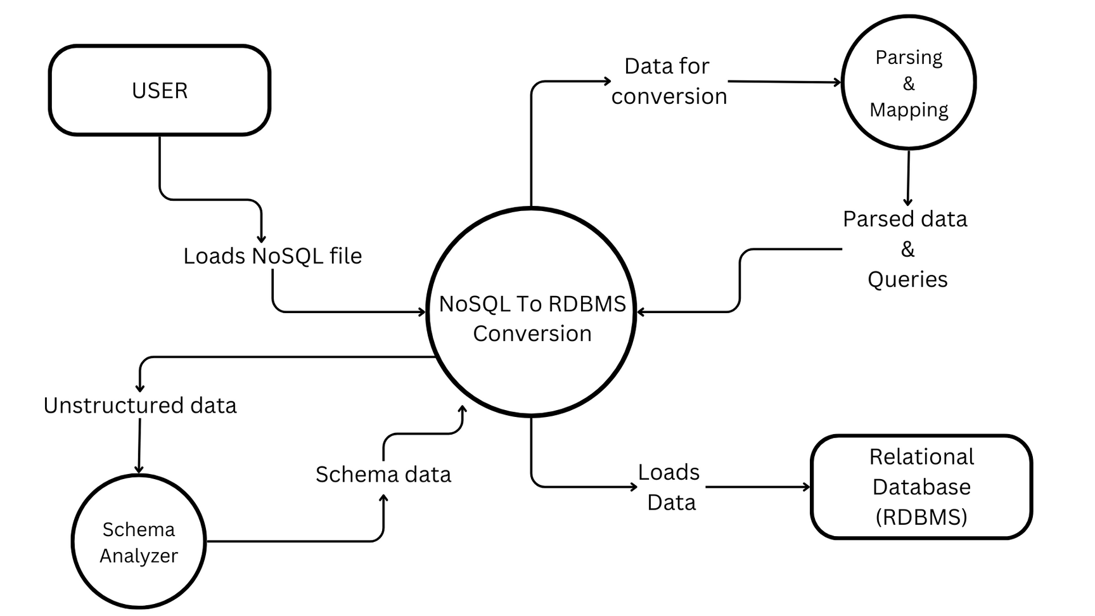
DATA FLOW DIAGRAM(DFD):

Slide 8
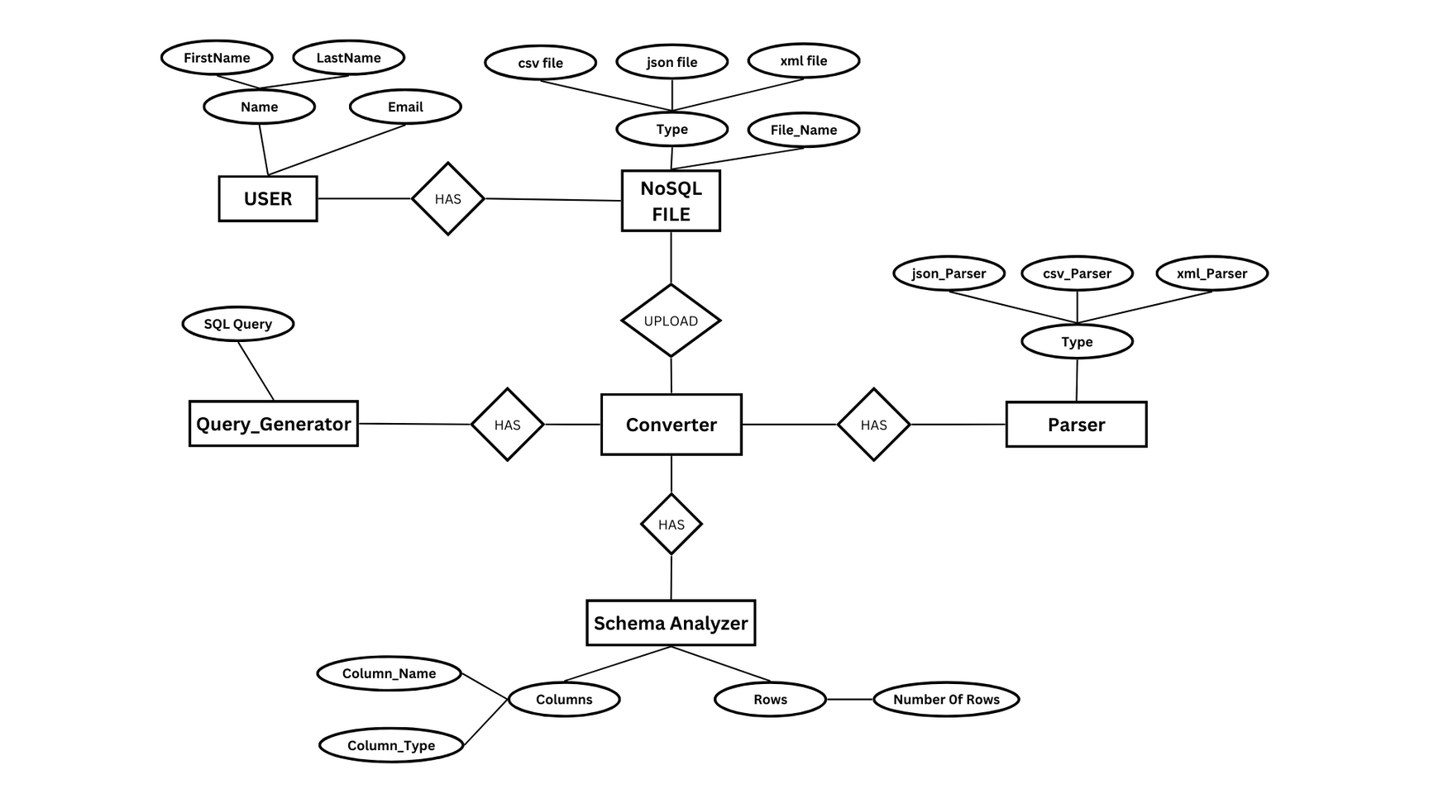
ER DIAGRAM:

Slide 9
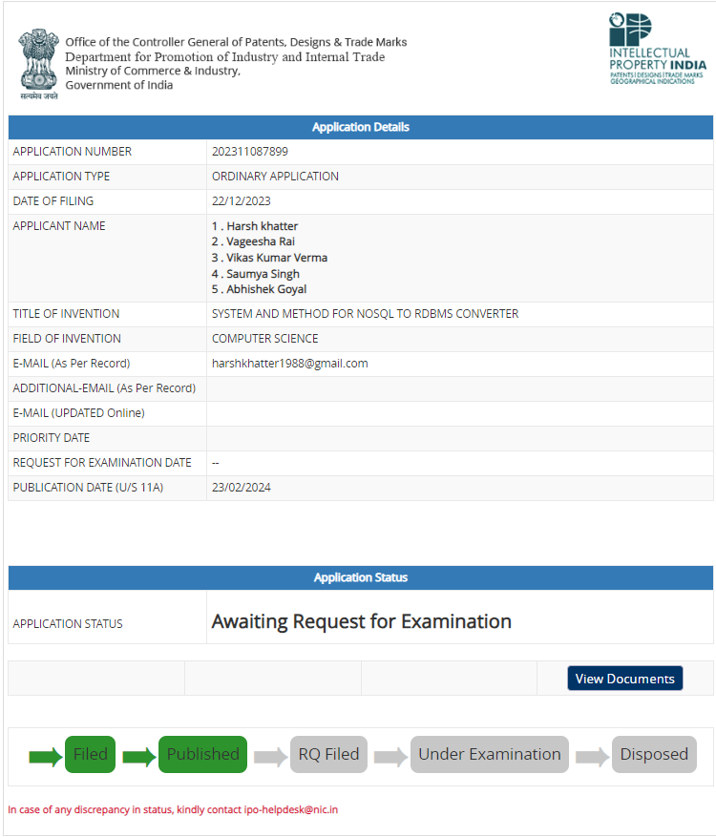
PATENT STATUS: PUBLISHED

Slide 10
Research Paper :
Status 1: Rejected
Link : https://drive.google.com/file/d/1ffircXW-hlwy_SPQyqlt8Ghep2GF9Jgc/view?usp=sharing
Submitted in “Confluence 2024 Amity university”.
Paper I’d : 629

Slide 11
Research Paper :
Status 2: SUBMITTED
Link : https://drive.google.com/file/d/1ffircXW-hlwy_SPQyqlt8Ghep2GF9Jgc/view?usp=sharing
Submitted in “ICCIET 2024 BVC Enggineering college”.
Paper I’d : 62

Slide 12
Testing Report :
Status : Completed
Link : https://drive.google.com/file/d/1qcCqOz0Syl479dEzqbhg5C9ctlzJjfje/view?usp=sharing

Slide 13
Previous Suggestions :
Usability/Applicability:
Banking sector
E-commerce
Readability
Security
Running Quereies Over data.
Big Data tools V/S Our model:
Big data tools are mostly Paid and not easily understandable.

Slide 14
REFERENCES:
[1]
Strauch, C., Martens, A., & Rumpe, B. (2017). "A Classification and Survey of NoSQL Databases". ACM Computing Surveys, 50(2), 1-38.
Kaur, M., & Kumar, S. (2015). "Challenges in Data Migration from NoSQL Databases to RDBMS". International Journal of Computer Applications, 116(10), 1-7.
Alomari, M. M., Lechner, G., & Gal, A. (2019). "Challenges of Data Migration Between NoSQL and SQL Databases." In Proceedings of the 2019 International Conference on Management of Data (COMAD), 145-152.
Yu, H., Varghese, B., & DeWitt, D. J. (2016). "Efficient Data Conversion and Loading for NoSQL Systems". In Proceedings of the VLDB Endowment, 9(10), 684-695.
Shah, S. H., & Patil, M. R. (2017). "NoSQL to SQL: A Review". International Journal of Computer Applications, 159(4), 23-29.
[2]
[3]

Slide 15
REFERENCES:
V. Gour, D. S. S. Sarangdevot, J. R. N. R. Vidyapeeth, G. S. Tanwar, and A. Sharma(2010).“Improve performance of extract, transform and load (ETL) in data warehouse,” International Journal on Computer Science and Engineering, vol. 2, no. 3, pp.786–789.
D. Skoutas and A. Simitsis(2006). “Designing ETL processes using semantic web technologies,” in Proceedings of the 9th ACM International Workshop on Data Warehousing and OLAP, DOLAP 06, ACM, New York, NY, USA, pp. 67–74.
M. Casters, R. Bouman, and J. Van Dongen, Pentaho Kettle Solutions(2010). Building Open Source ETL Solutions with Pentaho Data Integration, John Wiley & Sons, Hoboken, NJ, USA.
S. Ramzan, I. S. Bajwa, B. Ramzan, and W. Anwar(2019). “Intelligent data engineering for migration to NoSQL based secure environments,” IEEE Access, vol. 7, pp. 69042–69057.
A. K. Bhattacharjee, A. Mallick, A. Dey, and S. Bandyopadhyay(2013). “Enhanced technique for data cleaning in text file,” International Journal of Computer Science Issues (IJCSI), vol. 10, no. 5, p. 229.
[6]
[7]
[8]

Slide 16


